Slide 1
Division of Graduate Education (DGE) Graduate Research Fellowship Program (GRFP) NSFGRFP.org
Notes:
The Division of Graduate Education (DGE) advocates for innovative, inclusive, high quality graduate education in the STEM (Science, Technology, Engineering, and Mathematics) fields.
DGE manages innovative cross-Foundation programs that directly or indirectly support U.S. citizens and permanent residents in their quest to become the leading scientists and engineers of the future.
To better inform its programs, DGE supports research and other activities that will generate exciting new ideas for the graduate education of the future.

Slide 2
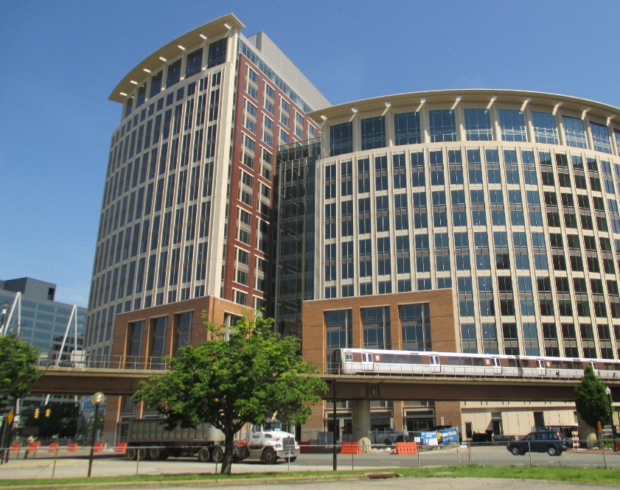
Graduate Research Fellowship Program (GRFP)
Directorate for STEM Education (EDU)
Division of Graduate Education (DGE)
www.nsf.gov/grfp
info@nsfgrfp.org
www.nsfgrfp.org

Slide 3
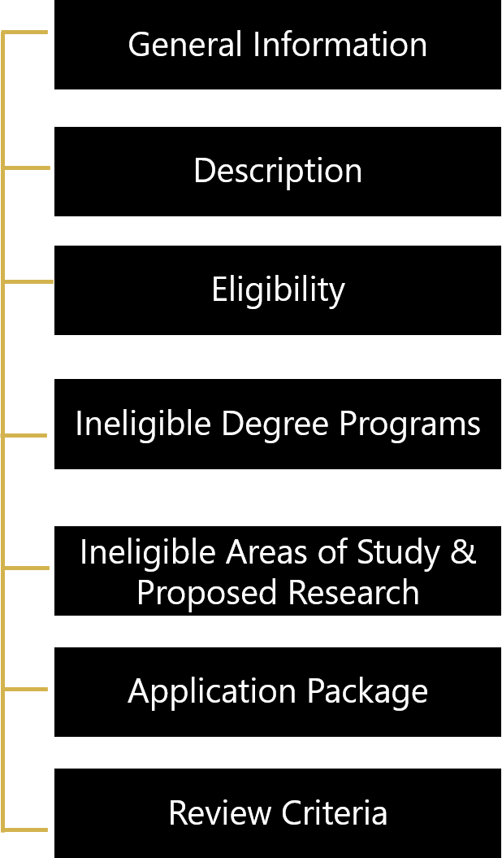
About GRFP

Slide 4
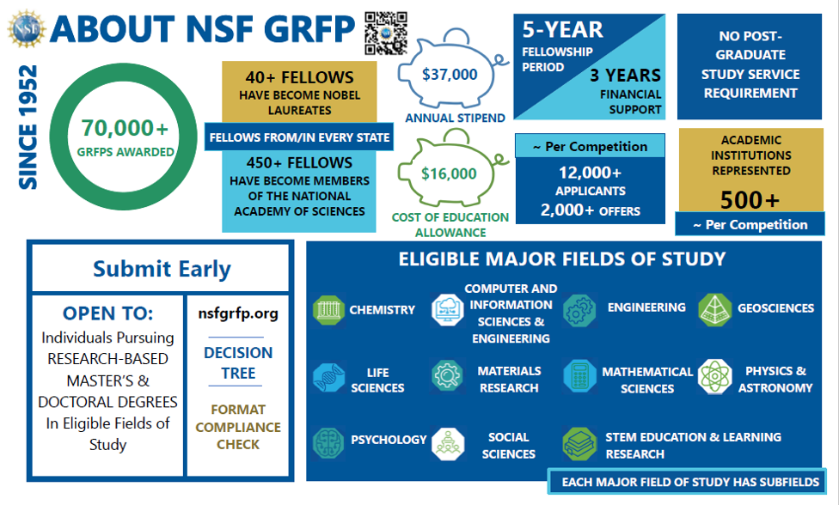
About NSF GRFP

Slide 5
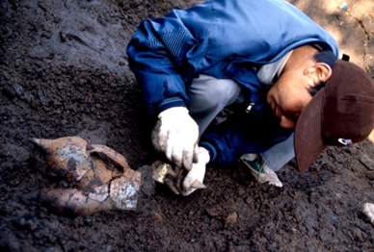
National Science Foundation
Graduate Research Fellowship Program (GRFP)
DESCRIPTION

Slide 6
NSF Graduate Research Fellowship
Five Year Awards – $159,000*
$53,000 each year for three years over five-year period
$37,000 stipend + $16,000 education allowance paid to institution
Payment covers all tuition and mandatory fees (no cost to student)
Other NSF Opportunities
INTERN – non-academic internship program
FASED Individuals with Disabilities support
Career-Life Balance Initiative (family leave)
*Amounts are based on GRFP Solicitation NSF 24-591 and subject to the availability of funds

Slide 7
GRFP Benefits
Fellowship: Awarded to individual, paid through the attended graduate institution
Flexible: Choice of project, advisor, and graduate program
Unrestricted: No service requirement after completion
Portable: Can be used at any accredited, non-profit, US institution of higher education, with campus in US for research-based master’s and doctoral degrees
2010 - 2022: ~2,000-2,100 Fellowships yearly
2022: ~12,600 Applications - ~18% success rate
2021: ~12,600 Applications - ~17% success rate
2020: ~12,800 Applications - ~16% success rate
2019: ~12,200 Applications - ~16% success rate

Slide 8
GRFP Goals
The overall goal of the Graduate Research Fellowship Program is to recruit individuals into Science, Technology, Engineering, and Mathematics (STEM) fields
To select, recognize, and financially support early-career individuals with the demonstrated potential to be high achieving scientists and engineers
To broaden participation of the full spectrum of diverse talents in STEM

Slide 9
NSF GRFP
Graduate Research Fellowship Program
(GRFP)
ELIGIBILITY

Slide 10
GRFP Eligibility NSF Solicitation 24-591
U.S. citizens, nationals, and permanent residents
Early-career: undergrad & graduate students
Pursuing research-based master’s and/or doctoral degrees (no professional degrees)
Science, Technology, Engineering, Mathematics (STEM) or STEM Education
Full-time enrollment in graduate degree program at accredited, non-profit US institution of higher education
NO foreign institutions
10

Slide 11
Ineligible Degree Programs
Professional degree programs
E.g., MBA, MD, JD, DVM, DDS, PharmD
Joint science-professional degree programs
E.g., MD/PhD, JD/PhD
Community, Global, or Public Health (MPH)
Counseling, Social Work (MSW)
Education (except STEM education)
Humanities (except history of science)
See Detailed Eligibility Requirements in the GRFP Solicitation

Slide 12
Ineligible Areas of Study and Proposed Research*
Research with directly health-related goals
Etiology, diagnosis, or treatment of disease or disorder
Animal models of disease for drug development/testing
Epidemiology
Disease prevention
Public, community, global health
Clinical research
Patient-oriented research
Epidemiological and behavioral studies
Outcomes research
Health services, standard of care, health policy
Research directly leading to clinical trials
Advocacy for specific policy outcomes
Applied research on plant pathology
Maximizing agricultural production
Impacts on food safety
* See GRFP solicitation NSF 24-591 for limited exceptions to ineligible areas of study and proposed research

Slide 13
Graduate Research Fellowship Program (GRFP)
Application Package

Slide 14
GRFP Application
Complete Application Package:
Personal Information, Education, Work/Research Experience, Proposed Major Field of Study, Honors, Awards, Publications
Personal, Relevant Background and Future Goals Statement (3-page PDF)
Graduate Research Statement (2-page PDF)
Transcripts (PDFs; mandatory)
Letters of reference (may provide up to five names of reference letter writers)
Mandatory: 3 reference writer names

Slide 15
GRFP Application Specifics
DEADLINES (5 p.m. local time of applicant mailing address):
Oct. 15, 2024: Chemistry, Geosciences, Mathematical Sciences, Physics & Astronomy
Oct. 16, 2024: Life Sciences
Oct. 17, 2024: Engineering
Oct. 18, 2024: Computer & Information Science & Engineering, Materials Research, Psychology, Social Sciences, STEM Education & Learning
Read the GRFP Solicitation for detailed application instructions and requirements!
To request accessibility accommodations, please contact info@nsfgrfp.org at least four weeks before the application deadline.

Slide 16
Example GRFP Application Timeline
Shortly After in
Mid October
Mid-October
Reference Letters Due
Applications Due

Slide 17
1) Personal, Relevant Background & Goals 2) Research Statement
Graduate Research Fellowship Program (GRFP)
Two Statements

Slide 18
Personal, Relevant Background & Goals
Tell your story; demonstrate your potential for STEM research
Experiences (professional and personal) that contributed to your motivation and preparation for pursuing a STEM career
Career aspirations and future goals
How have your experiences shaped your goals?
Research, industrial, professional experience
What was the project, what was your role?
How did you become involved? Where was it done?
Why was this project worth doing? What have you learned? Any advanced course work?
What was your contribution to the project and how did it fit into the whole?
18

Slide 19
Research Statement
Describe your proposed research plan:
Communicate your research idea and approach
Explain your research plan and methods
What do you expect to learn? How will you know if the project is successful?
What would you do next?
Keep in mind:
Avoid jargon
Communicate clearly for non-specialists
Make your contributions clear
Clearly address NSF’s Merit Review Criteria – Intellectual Merit and Broader Impacts – under separate headings
19

Slide 20
Reference Letters & Transcripts
Reference Letters
MANDATORY for Application Review
3 reference writer names in the application
2 reference letters must be received by NSF
STRONGLY RECOMMENDED
List up to 5 names of reference writers
3 reference letters received by NSF
List and rank up to 5 reference letter writers - Top 3 will be seen by reviewers
Transcripts – Required
All applicants must submit Bachelor’s degree transcript
Transcripts required for all degree programs
Transcripts required for all graduate degree enrollment
Official or unofficial transcripts accepted
Official transcripts recommended for 2nd year graduate students

Slide 21
Graduate Research Fellowship Program (GRFP)
Review Criteria

Slide 22
Comprehensive Review National Science Board Merit Review Criteria
Intellectual Merit
How important is the proposed activity to advancing knowledge within its own field or across different fields?
Broader Impacts
How well does the proposed activity benefit society or advance desired societal outcomes?

Slide 23
Comprehensive Review National Science Board Merit Review Criteria
Review considerations:
Demonstrated potential for significant achievement in STEM
Comprehensive approach to review
Balanced consideration to all components of the application
educational and research record, leadership, outreach, service activities, plans for the future, individual competencies, experiences, and other attributes

Slide 24
Intellectual Merit Potential to advance knowledge
Evidence of potential and ability:
Demonstrated intellectual ability (grades, curricula, awards, publications, presentations, etc.)
Plan and conduct research
Work as a member of a team as well as independently
Interpret and communicate research
Take initiative, solve problems, persist
Display the potential of your approach to your major field of study and your Research Plan to advance knowledge
Evidence of Intellectual Merit can be found in all parts of the application: Personal Statement, Research Plan, letters, experiences, awards, achievements, and transcripts
24

Slide 25
Broader Impacts Potential impact of the individual or research on society
Societal benefits may include, but are not limited to:
Increasing participation of the full spectrum of diverse talents in STEM
Engaging in mentoring; improving STEM education in schools
Increasing public scientific literacy; increased public engagement with STEM
Conducting community outreach: science clubs, radio, TV, newspapers, blogs
Increasing collaboration between academia, industry, others
Evidence of Broader Impacts can be in all parts of the application: Personal Statement, Research Plan, letters, experiences, awards, achievements
25

Slide 26
Thank you!
nsfgrfp.org
Graduate Research Fellowship Program (GRFP)
Program Contacts
info@nsfgrfp.org
Applicants: nsfgrfp.org/applicants
GRFP Reference Writers: nsfgrfp.org/reference_writers
GRFP Reviewers: nsfgrfp.org/reviewers
866-NSF-GRFP, 866-673-4737
(toll-free from the US & Canada)
202-331-3542 (international)

Slide 27
27

